Slide 1

Polytene Chromosome
Molecular Genetics Laboratory
BT 344

Slide 2
Objectives
Introduction
Importance
Morphology of polytene chromosome
Drosophila’s polytene chromosome
Functional stages in polytene
Mutations in polytene
Procedure

Slide 3
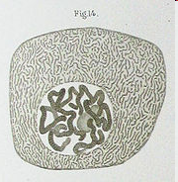
Polytene Chromosome
Observed 1st time by E.G. Balbiani in 1881.
Also known as Salivary Gland Chromosomes/ Giant Chromosomes.
Found in the salivary gland of dipteran species eg. Chironomuslarva, Drosophila melanogaster.
Polytene chromosomes in a Chironimus salivary gland cell

Slide 4
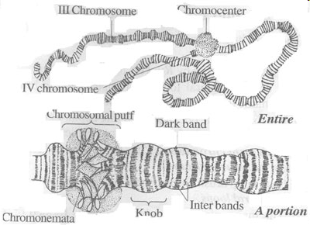
Also found in various tissues (salivary, midgut, rectal, and malpighian excretory tubules) in the larvae of some flies as well as in several species of protozoans and plants.

Slide 5
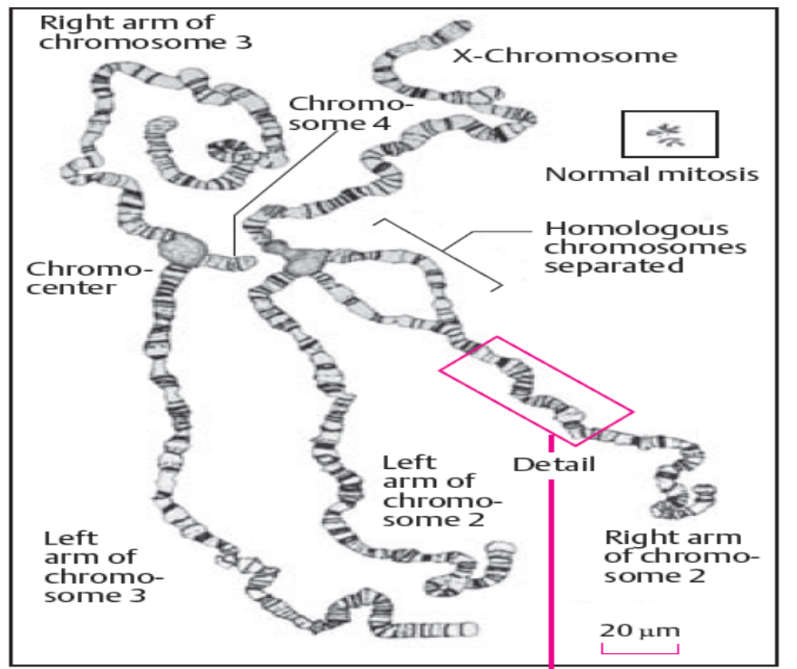

Slide 6
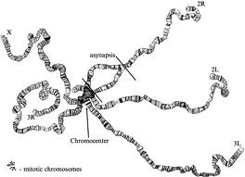

Slide 7
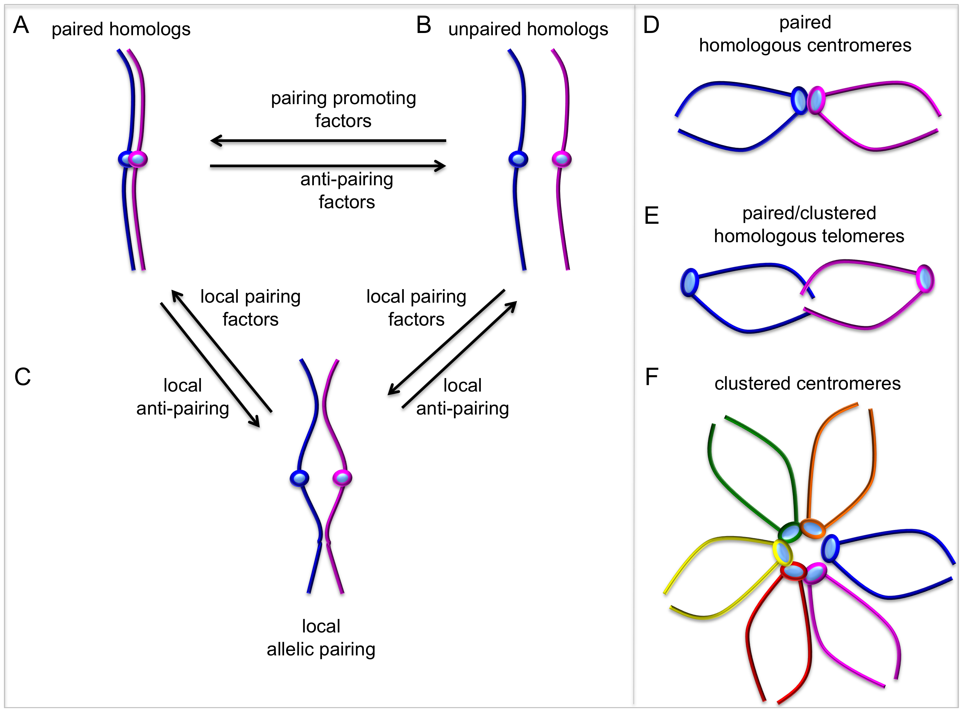

Slide 8
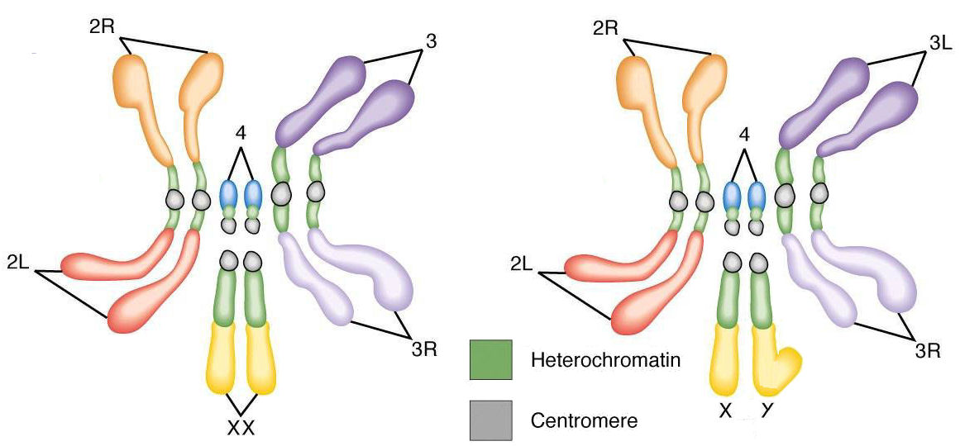

Slide 9
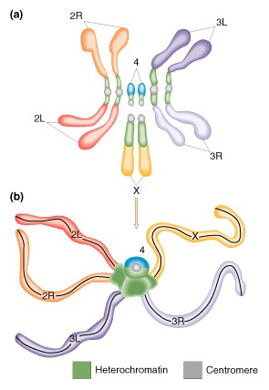
Chromocenter

Slide 10
Why are they known as Giant Chromosomes?
In Drosophila melanogaster it is 1000 times larger than somatic chromosomes.
The larger size of the chromosomes is due to the presence of many longitudinal strands called chromonemata.
Hence they are also called Polytene chromosomes (many threaded).
The many strands of the giant chromosomes are due to repeated division of the chromosome without the cytoplasmic division/mitosis. This type division is called endoreduplication/Endoreplication.
Polytene chromosomes may be as long as 0.5mm, and up to 20mm in diameter

Slide 11
Why they are known as Giant Chromosomes?
Drosophila chromosomes has been replicated through 10 cycles without separation of the daughter chromosomes, so that 1024 (= 2¹⁰) identical strands of chromatin are lined up side by side.
Each polytene chromosome is 200 to 600µm long.
Polytene homologues are held together by somatic pairing.
Cells with more than the normal complement of chromosomes are polyploid.

Slide 12
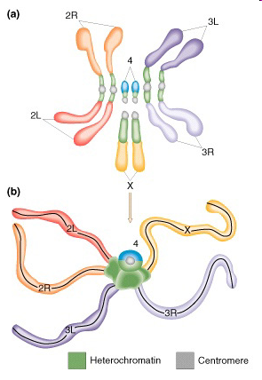
In D. melanogaster, the giant chromosome are in the form of 5 long and one short strands radiating from a single more or less amorphous mass known as chromocentre.
One long strand – X-Chromosome
And the remaining 4 long strand are the arms of II & III chromosomes.
The centromere of all these chromosomes fuse to form the chromocentre.
In male flies the Y chromosome is also fused with the chromocentre and hence not seen as a separate strand.

Slide 13
The centromeres of all four chromosomes of D. melanogaster aggregate to form a chromocenter that consists largely of heterochromatin.

Slide 14
Polytenization
Polytenization, occurs when the DNA repeatedly replicates, but the daughter chromosomes do not separate.
The result is an enlarged chromosome composed of many parallel copies of itself
The amplification of chromosomal DNA greatly increases gene copy number, presumably to supply sufficient mRNA for protein synthesis in the massive salivary gland cells.

Slide 15
Importance
To increase cell volume, increasing the volume of the cell's nuclei and causing cell expansion
To incease the gene expression (metabolic advantage), where multiple copies of genes permits a high level of gene expression.
In Drosophila melanogaster, for example, the chromosomes of the larval salivary glands undergo many rounds of endoreplication, to produce large amounts of glue before pupation.

Slide 16
Because polytene chromosomes are interphase chromosomes, and are therefore transcribed, Dipteran polytene chromosomes provide an opportunity to study transcription by direct observation, and transcriptional responses to specific stimuli can be observed.

Slide 17
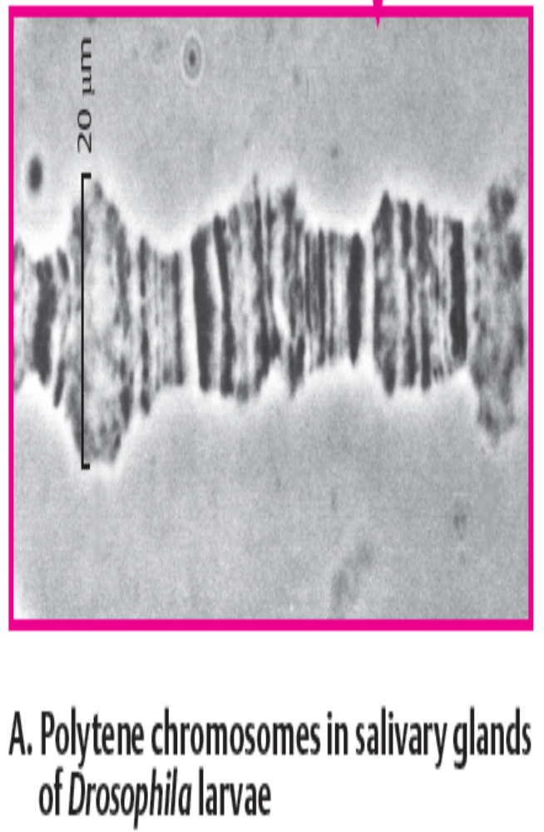
Band Pattern
The Polytene chromosome contains two types of transverse bands, namely dark bands and inter bands.
The dark bands are darkly stained and the inter bands are lightly stained with nuclear stains.
The dark bands contain more DNA and less RNA.
The inter bands contain more RNA and less DNA.

Slide 18
Band Pattern
About 85% of the DNA in polytene chromosomes is in bands, and 15% is in interbands.
Since the bands can be recognized by their different thicknesses and spacings, each one has been given a number to generate a polytene chromosome "map."
The bands in Drosophila polytene chromosomes represent 50,000–100,000 base pairs.
There are approximately 5000 bands in the total Drosophila genome.

Slide 19
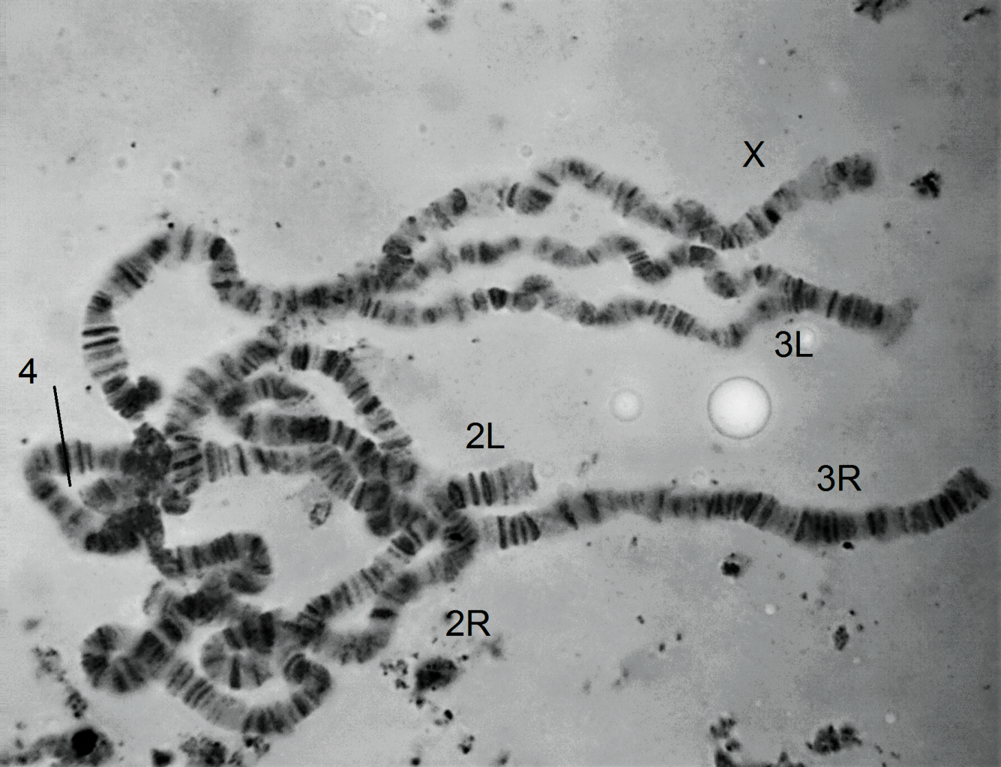

Slide 20
Drosophila's Polytene Chromosomes
These chromosomes, first observed in cells of insect salivary glands of Drosophila.
Found in salivary glands and other tissues of flies.
Drosophila melanogaster has 8 chromosomes.
The reference system proposed by Calvin Bridges in 1935 divides the limbs of salivary gland chromosomes into 102 sections called "divisions" designated by number from 1 to 102

Slide 21
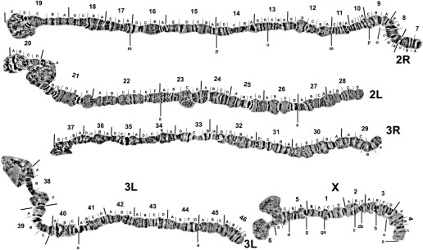

Slide 22
Drosophila's Polytene Chromosomes
Each of the five main limbs (X, 2L, 2R, 3L, and 3R) contains 20 divisions; the short chromosome 4 contains only two divisions.
The divisions are started with a prominent band and divided further into 6 subdivisions, each designated with capital letters from A to F.
Individual band of salivary gland chromosomes can be identified by giving the division number, subdivision, and the number of the band starting from the beginning of the subdivision.

Slide 23
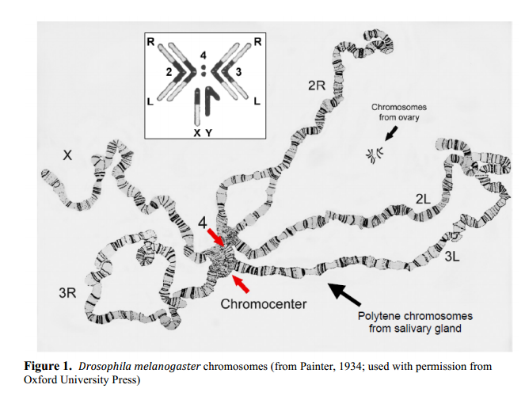

Slide 24
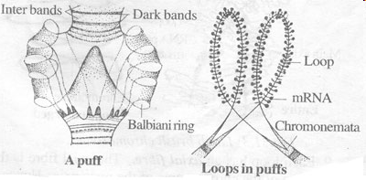
Puffs / Balbiani Rings
The bands of Polytene chromosomes become enlarged at certain times to form swellings called puffs or Balbiani rings.
The formation of puffs is called puffing.
In the regions of puffs the chromonemata uncoil and open out from many loops.
The puffs indicate the site active genes when mRNA synthesis takes place.

Slide 25
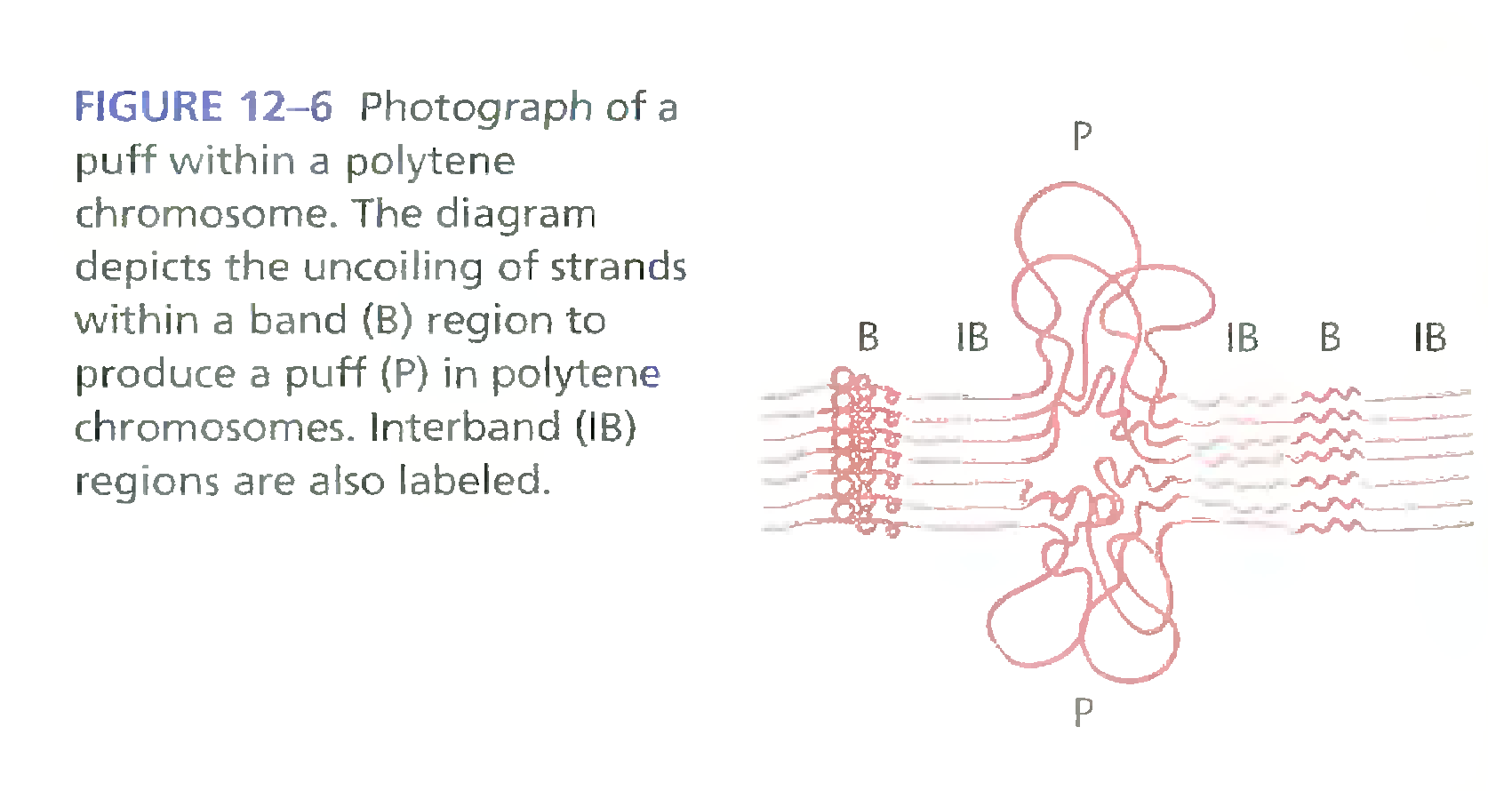
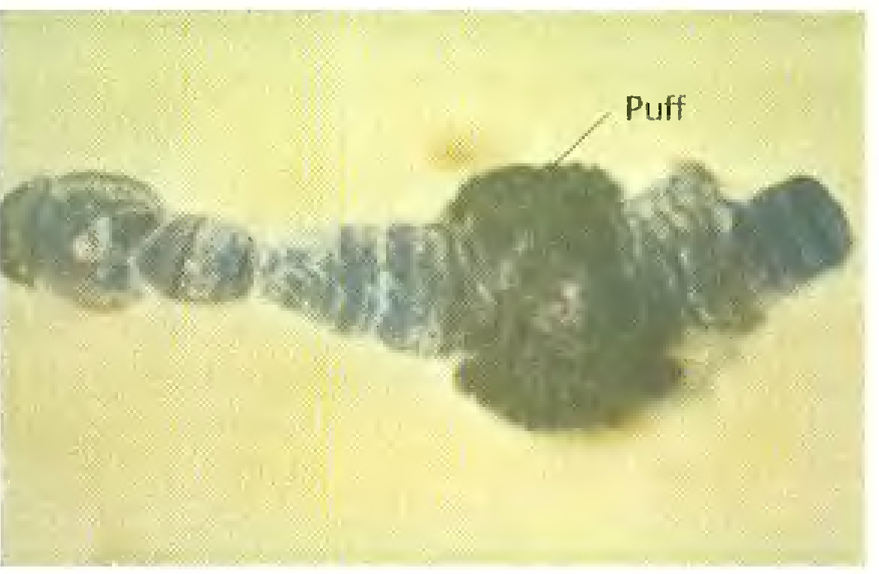

Slide 26
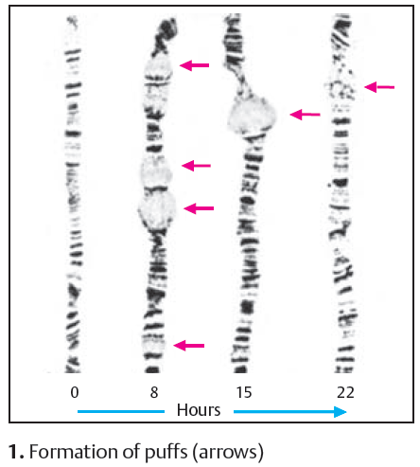

Slide 27
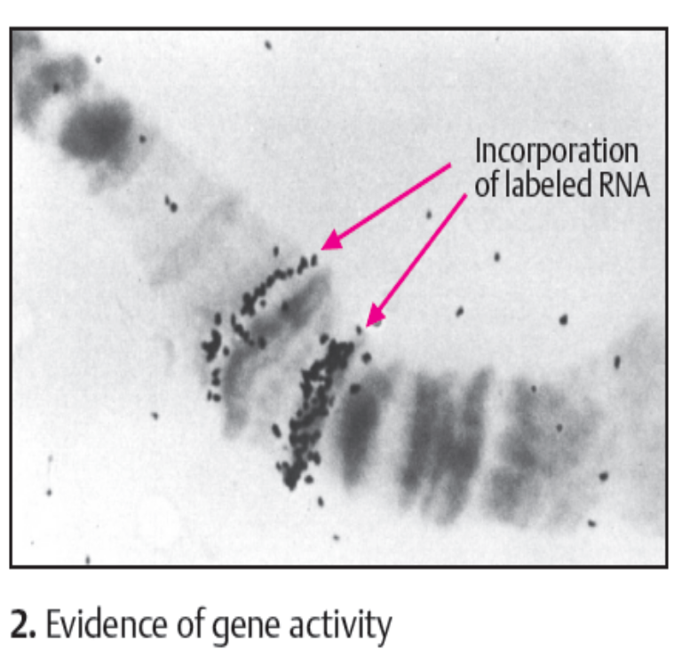
Puffs / Balbiani Rings
The incorporation of radioactively labeled RNA has been used to demonstrate that RNA synthesis occurs in these regions as a sign of gene activity (transcription).

Slide 28
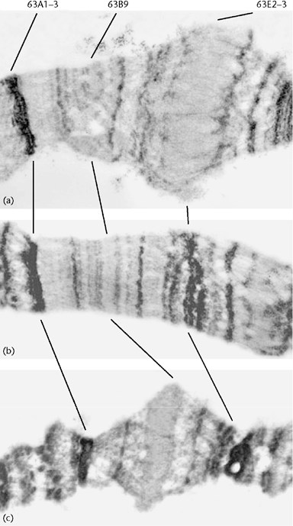
Normal
Heat shock

Slide 29
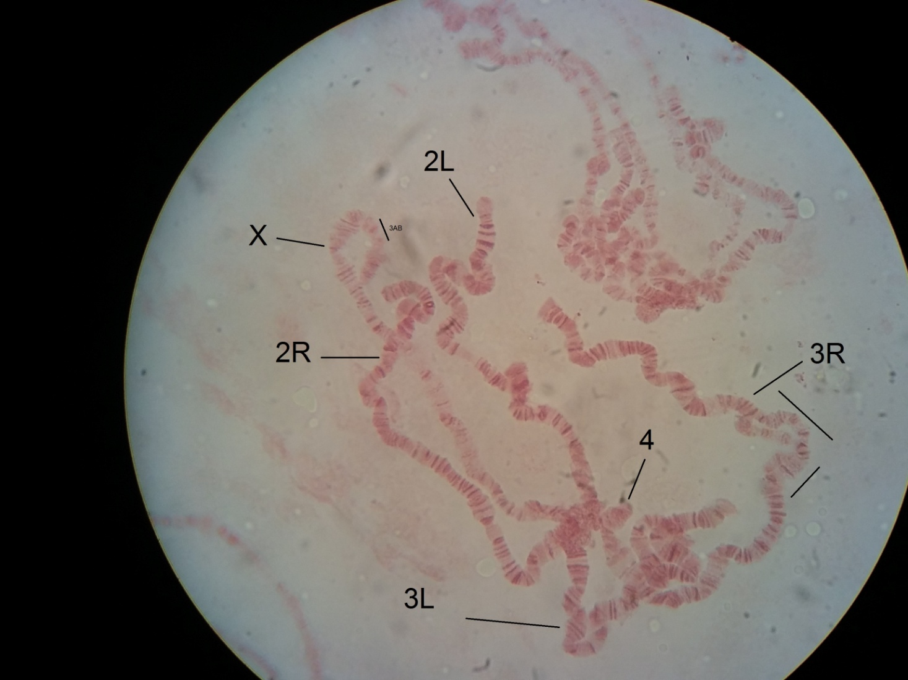
Puff

Slide 30
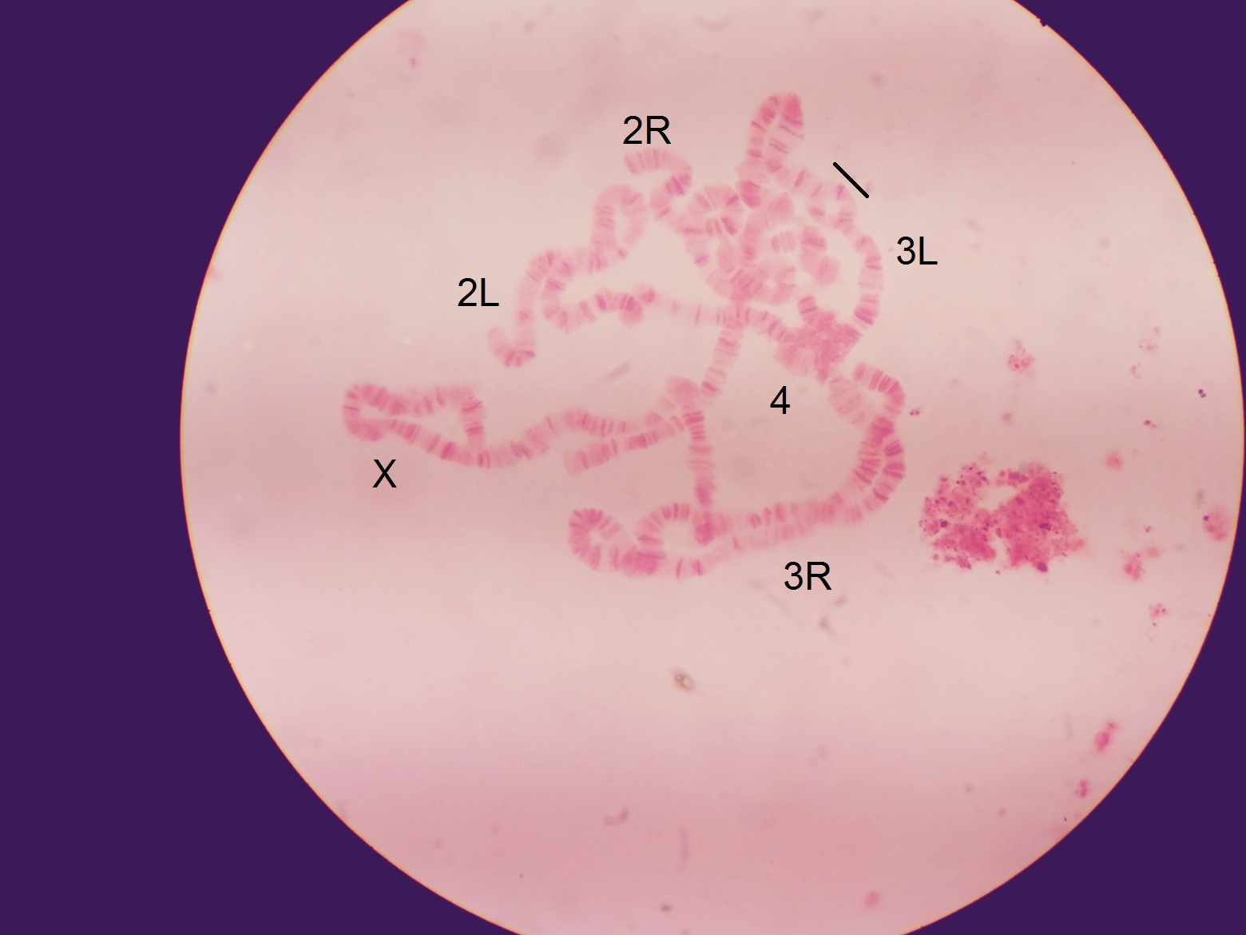

Slide 31
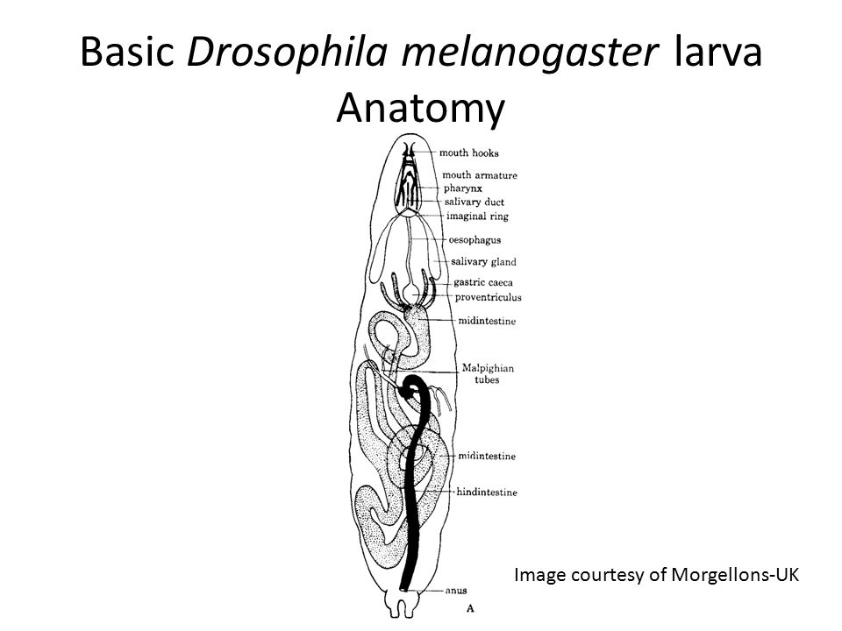


Slide 32
Isolation of Larval Salivary Glands
https://www.youtube.com/watch?v=vVOhHFAazCo
https://www.youtube.com/watch?v=FYwFo-QSqNo

Slide 33
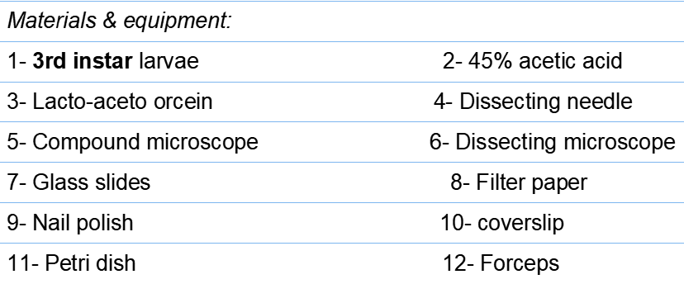
Procedure

Slide 34
Procedure
1. Using a forcep, select large, third instar larvae.
2. Place larvae in a petri dish contains thin layer of distilled water and shake the container to rinse away media adhering to the body wall
3. Transfer a single larva using forceps to a glass slide containing a large drop of 45% acetic acid and place the slide on the stage of a dissecting scope.
4. Firmly grasp the head end of the larva at the base of the mouth hooks with a needle and quickly grasp about three-quarters along the length of the body with a second pair of forceps. In a quick move, pull off the head end using the needle.
5. Isolate the glands and clean off the fatty tissue. Then, using filter paper remove the remaining of the larval body.

Slide 35
6. Put another drop of 45% acetic acids and allow glands to fix for 2—5 min (3 min preferred).
7. Remove the acetic acid using filter paper and add a drop of lacto—aceto-orcein stain on the slide and allow to stain for 5-10 min. Do not let stain evaporate (put a humid chamber over it).
8. Drop a cover slip on the preparation, allow stain to spread, and gently tap the cover slip with a dissecting needle or blunt pencil.
9. Remove excess stain with filter paper.
10. Observe polytene chromosome under a compound microscope at 100X magnification.

